Slide 1
Non-Conventional Language Models
Instructor: Kyunghyun Cho (NYU, Facebook)

Slide 2
Let’s talk BERT*
Three ways to talk BERT
How well does it initialize a classifier?
What kind of (linguistic) features does BERT capture?
What was BERT trained to do?
* There are many more and less recent variants of BERT, and I use “BERT” to refer to any undirected language model.

Slide 3
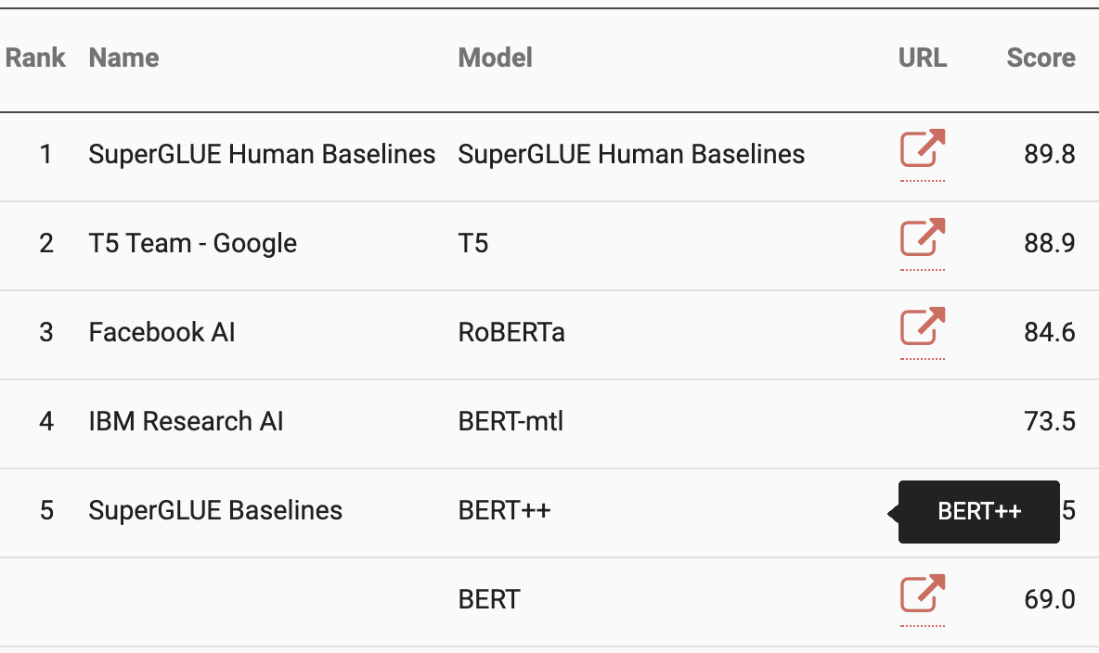
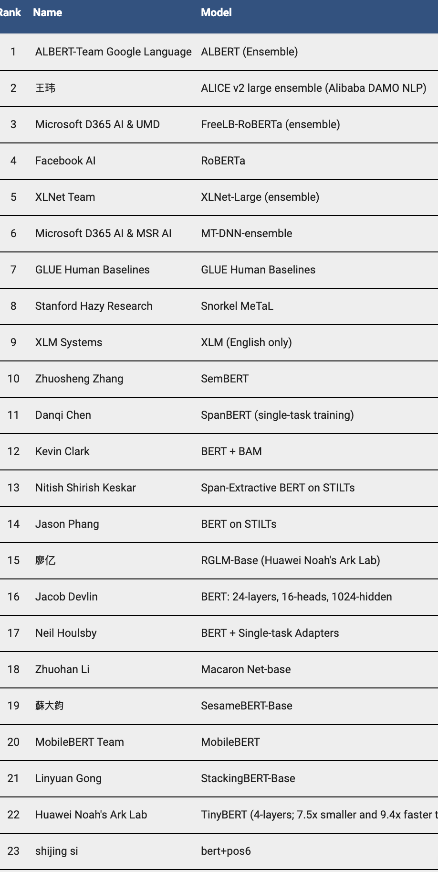
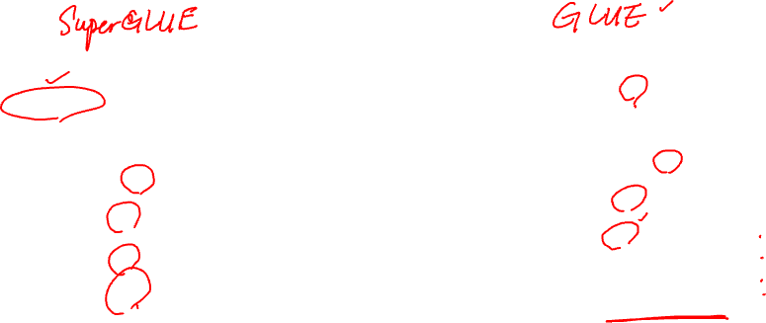
How well does it initialize a classifier? – Very

Slide 4
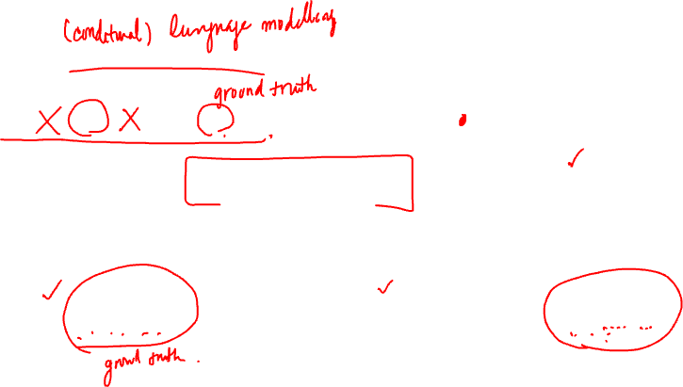
What was BERT trained to do?
BERT learns a distribution by learning as many conditionals as possible
BERT
Div

Slide 5
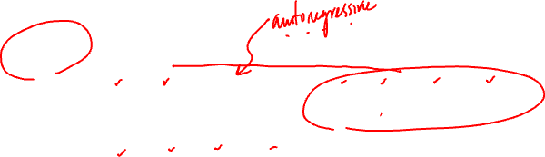
If BERT learns a distribution, can we generate from it?
Searching for a directed, acyclic graph* that covers all the variables
The optimal dependency structure is conditioned on the input C
Pointed out recently by McAllester as well in his blog post
…
…
* it’s not necessary to be acyclic in general as long as we constrain the number of visits per node in topological sweep.

Slide 6
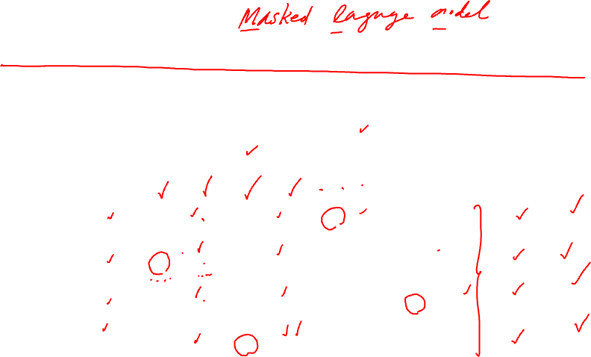
Generalized framework of sequence generation
Alternates between
Determine the next set of variables to replace
Sample each selected variable
0
0
1
0
1
0
0
0
BERT
BERT
BERT
BERT
0
0
0
1
0
1
0
0

Slide 7
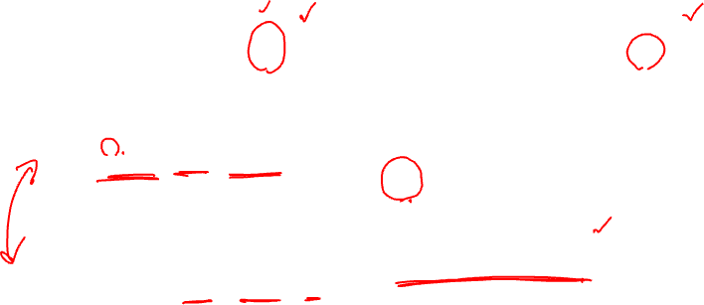
Generalized framework of sequence generation
Ordering + generation can be framed as where and
Mansimov, Wang, Welleck & Cho [2020; under review]

Slide 8
Generation from BERT = Dependency* Detection
BERT has already learned conditionals
How do we decide a set of variables at each iteration?
Mansimov, Wang, Welleck & Cho [2020; under review]

Slide 9
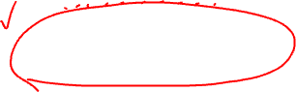
Confession of a deep learner
A log-linear model with manually crafted features and coefficients
Features
Monotonicity:
Predictability:
Uncertainty:
Coefficients
Manually set them to induce desired properties
Uniform, left-to-right, easy-first, least-to-most, …
Mansimov, Wang, Welleck & Cho [2020; under review]

Slide 10
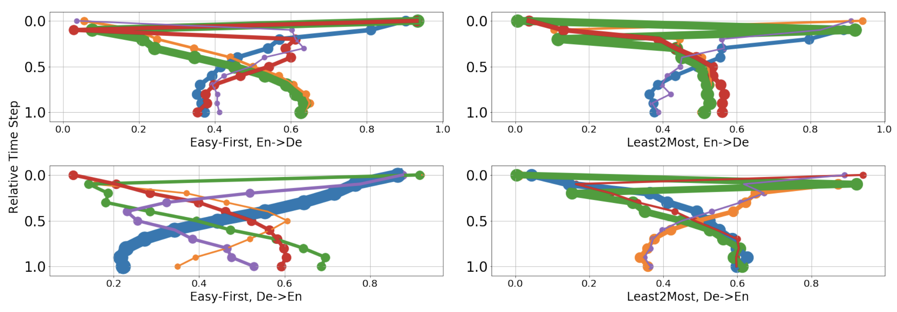
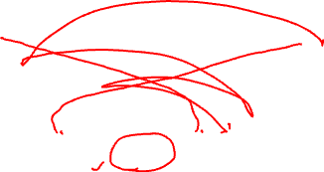
Beam search & adaptive generation order
Because of our formulation, we can beam search with BERT
Over the choice of words as well as the choice of variables*
Different search strategies lead to different order of generation
* though, for experiments, we only beam searched over the choice of words.

Slide 11
Source | Doch ohne zivilgesellschaftliche Organisationen könne eine Demokratie nicht funktionieren .
 | _ _ _ _ _ _ _ _ _ _ _
 | _ _ _ _ _ _ _ _ _ _ .
 | _ _ _ _ _ _ _ _ cannot _ .
 | _ _ _ _ _ _ _ democracy cannot _ .
 | _ without _ _ _ _ _ democracy cannot _ .
 | _ without _ _ _ _ _ democracy cannot work .
 | But without _ _ _ _ _ democracy cannot work .
 | But without _ society _ _ _ democracy cannot work .
 | But without civil _ _ , _ democracy cannot work .
 | But without civil society _ , _ democracy cannot work .
 | But without civil society organisations , _ democracy cannot work .
 | But without civil society organisations , a democracy cannot work .
Reference | Yet without civil society organisations , a democracy cannot function .

Slide 12
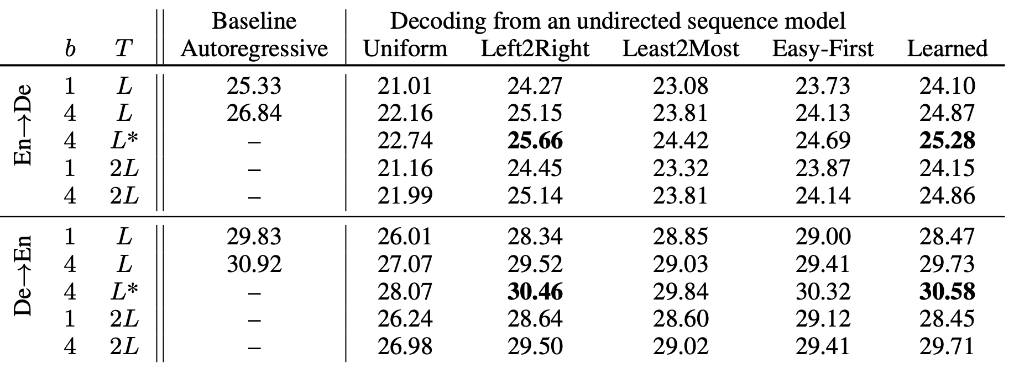
Some results
Mansimov, Wang, Welleck & Cho [2020; under review]

Slide 13
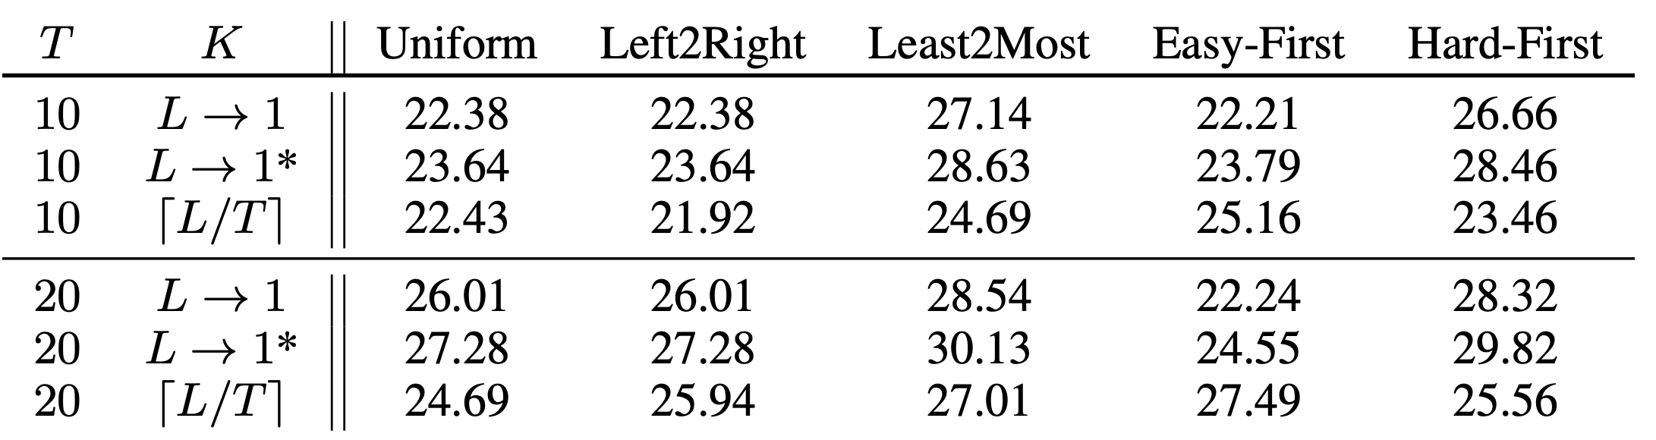
But, some interesting implications: Constant-time machine translation
With enough parallel compute, each iteration is constant w.r.t. length
Initially put forward by Ghazvininejad et al. [2019]

Slide 14
Sequence generation with an adaptive order
BERT Generation
Ghazvininejad et al. and Lawrence et al. at EMNLP 2019
Learned-order generation
Welleck et al. [2019], Gu et al. [2019], Stern et al. [2019], Chan et al. [2019], Emelianenko et al. [2019], etc.

Slide 15
Probabilistic sequence modeling
, where
From a finite set of data points
Three ways to go
Build a table containing all possible for each to store probabilities
Factorize the table: e.g., autoregressive models
Smooth the table: e.g., latent variable models

Slide 16
Latent variable models
Latent variables capture the dependencies
, but after marginalization
…
…
…
…

Slide 17
Latent variable models
Notoriously difficult to fit a latent variable model
Principal component analysis [Pearson, 1901], Boltzmann machines [Ackley et al., 1985], Helmholtz free energy [Hinton, 1994], wake-sleep algorithm [Hinton et al., 1995], independent component analysis [Comon, 1994; Bell&Sejnowski, 1995; Hyvarinen et al., 2000], contrastive divergence [Hinton, 2002], deep belief nets [Hinton et al., 2006], denoising autoencoders [Vincent et al., 2009], … and my entire PhD dissertation…
Because, it’s difficult to marginalize the latent variables

Slide 18
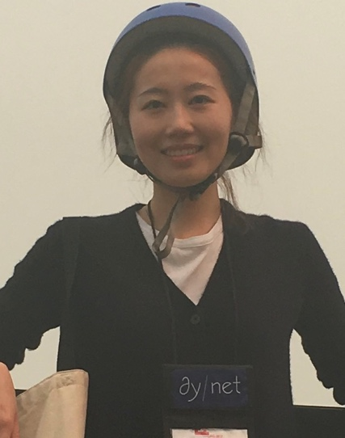
Variational autoencoders
Maximizing the lowerbound instead with an approximate posterior q
Reparametrization trick to estimate the gradient w.r.t. q with a minimal variance
Proposed by Kingma & Welling [2013] and Rezende et al. [2014]
A stream of studies applying VAE to NLP
VAE Language models [Bowman et al., 2016], VAE Seq2seq [Zhang et al., 2016; Zhou&Neubig, 2017; Shah&Barber, 2018], …

Slide 19
Learning is easy, but generation is not…
Generation is equivalent to solving
It is not equivalent to
Sadly, this has been a common practice
“During decoding, however, due to the absence of target sentence y, we set h_{z} to be the mean of p_{θ}(z|x), i.e., µ’.” Zhang et al. [2016]
“We do not marginalize over the latent variable z however, instead we use the mode µ of z as the latent representation for z” Zhou&Neubig [2017]

Slide 20

Deterministic inference algorithm
Delta posterior
Alternating between two steps until convergence
Fit the delta posterior
Maximize the lowerbound using q’
[Shu et al., 2019; rejected]
A stochastic version of this algorithm was proposed by Shah&Barber [2018]. So, novelty 👎

Slide 21
Alternating optimization enables big jumps
Continuous latent space
Discrete sequence space

Slide 22
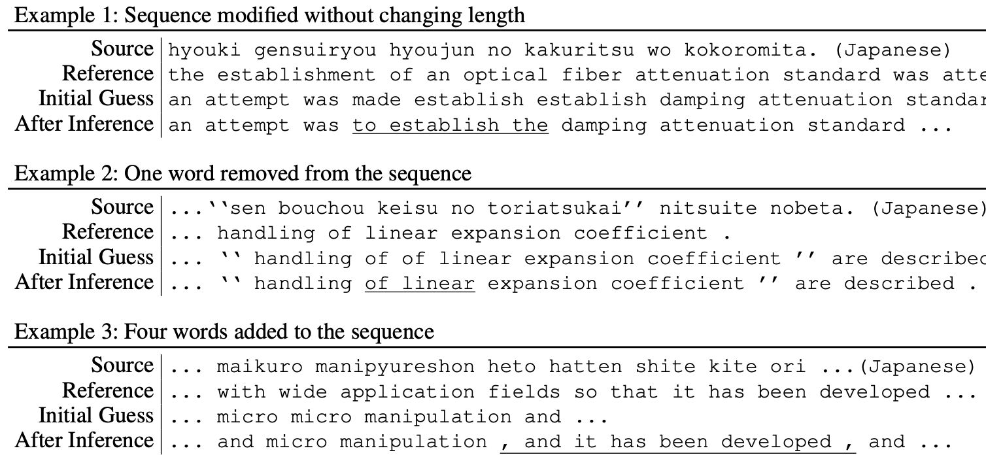
Latent variables allow inference to make jumps
[Shu et al., 2020; Lee et al., 2020]

Slide 23
Better quality-efficiency trade-off
Continuous space results in a better tradeoff between efficiency and quality
Continuous space provides us with a more fine-grained control over the trade-off
[Lee et al., 2020]

Slide 24
Still not state-of-the-art, but pretty efficient
Autoregressive transformer (26.1, 1x)
Iter 3, 12.5x
Iter 0, 22x
Iter 1
Iter 3
Iter 1
Iter 3
Iter 3
Iter 0
[Shu et al., 2020]

Slide 25
Almost state-of-the-art in a simpler domain
Ja-En ASPEC [Nakazawa et al., 2016]
Limited to scientific domains
A narrower set of sentence styles
Src | 標記 減 衰 量 標準 の 確立 を 試み た 。
Initial | an attempt was to establish the damping attenuation standard ...
After | an attempt tries to establish the damping quantity standard ...
Ref | an attempt was made establish establish damping attenuation standard ...

Slide 26
In this lecture, we learned
Undirected (masked) language models
How to generate from a masked language model
How to learn the order of generation from a masked language model
Latent-variable non-autoregressive machine translation
How to construct a latent-variable model
How to perform generation using iterative refinement

